Slide 1
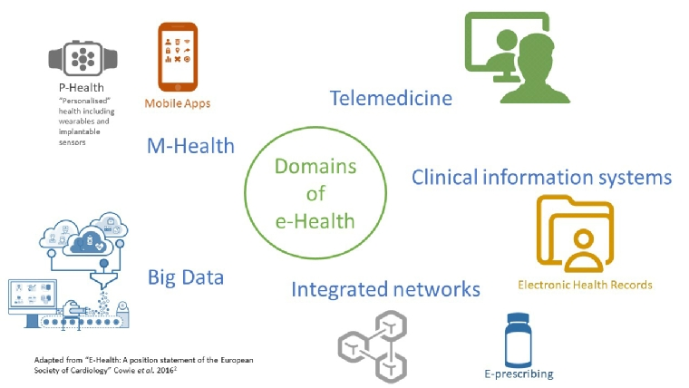
The Attitudes of Greek Citizens toward e-Health before-during-post pandemic Crisis
Kleio Marina Katogianni
PhD Candidate Of University Of Alicante
INTRODUCTION
ETHICS
The importance of technology in the healthcare sector cannot be overstated. Technology has transformed the way healthcare is delivered, from electronic health records (EHRs) to telemedicine and wearable health devices. It has enabled better communication between healthcare providers, improved patient outcomes, and increased access to healthcare services. Additionally, technology has facilitated collecting and analyzing large amounts of health data, leading to advancements in personalized medicine and predictive analytics. Overall, technology is critical in improving efficiency, reducing medical errors, and ultimately enhancing the quality of care in the healthcare sector.
Despite concerns about privacy and security, digital health has the potential to revolutionize healthcare through personalized medicine and big data analytics. While there is a high level of e-health literacy, some populations exhibit apprehension. The pandemic is expected to improve citizens' views about e-health. Overall, digital health has the potential to enhance healthcare outcomes significantly. However, it is crucial to ensure data privacy and security. Over the years, attitudes have likely changed, and eHealth tools have become a massive part of our lives.
Outcome
Despite past research that wanted the health patients of Greece to be wary of electronic health and its applications, the present research aims at more positive results of the mediation of the pandemic that faced both health professionals and the rest of the users with new conditions, where the remote provision of health services appeared to be the best possible solution. Due to the necessity of using e-health and the facility it has .
Source – Data Measurement
Information Technology Attitude Scales for Health (ITASH) questionnaire (Ward et al, 2009).
5-point closed Likert scale "5=strongly agree 1=strongly disagree".
Data were fitted to the Statistical Package for Social Sciences (SPSS) Version 26.0 statistical package.
We will distribute the questionnaire electronically through social networking platforms and email it to a random sample of people in different geographical areas of the country.
Participants will have three months to complete the survey. We will also distribute the ITASH questionnaire along with a questionnaire that includes demographic data of the citizens.
STUDY SITE & PARTICIPANTS
Conducting online space using social media
Source population: all the inhabitants of the country
Subject: those who participated in the research
The author of the original questionnaire was contacted to obtain permission for its use and translation in the research.
Prior to data collection, research participants were duly informed of the research's objectives and were guaranteed anonymity and confidentiality of the information gathered.
STUDY DESIGN
REFERENCES
The type of study chosen is the cross-sectional study in which the measurement of the outcome and the determinants will take place at a specific time and the reception of the information on the outcome will be done at the same time as the reception of identifier information.
ANALYSIS
It will be used descriptive and inductive methods:
Measures of position and dispersion, namely mean and standard deviation.
Average pie & bar graphs.
Hyfantis, T., & Giannouli, V. (2017). In The Labyrinth of e-Health: Exploring Attitudes towards e-Health in Greece. *Journal of Psychology and Clinical Psychiatry.* https://medcraveonline.com/JPCPY/JPCPY-08-00474.pdf
Stroetmann, V., & Birov, S. (2021). Digital Health Transformation in Europe – Recommendations are on the Horizon. *Health Management, 21*(5), https://healthmanagement.org/c/healthmanagement/issuearticle/digital-health-transformation-in-europe-recommendations-are-on-the-horizon.
Dopelt, K., Avni, N., Haimov-Sadikov, Y., Golan, I., & Davidovitch, N. (2021). Telemedicine and eHealth Literacy in the Era of COVID-19: A Cross-Sectional Study in a Peripheral Clinic in Israel. *International Journal of Environmental Research and Public Health*, https://www.mdpi.com/1660-4601/18/18/9556.
Angelidis, P., Giest, S., Dumortier, J., Artmann, J., & Heywood, J. (2010). Country Brief: Greece. *European Commission, DG Information Society and Media*, http://www.ehealth-strategies.eu/database/documents/Greece_CountryBrief_eHStrategies.pdf.
MATERIALS AND METHODS:
.
OBJECTIVE
The study focuses on examining the opinions of Greek citizens, including health professionals and the public, towards electronic health and its applications before, during, and after the COVID-19 pandemic. It aims to explore the factors influencing their attitudes toward e-health and track the evolution of these opinions over time. The study will employ a comprehensive research methodology, examining the receptivity or wariness of health users towards the development of health services as the dependent variable, and demographic factors, digital skills, and the relationship with electronic devices as independent variables.

